Slide 1

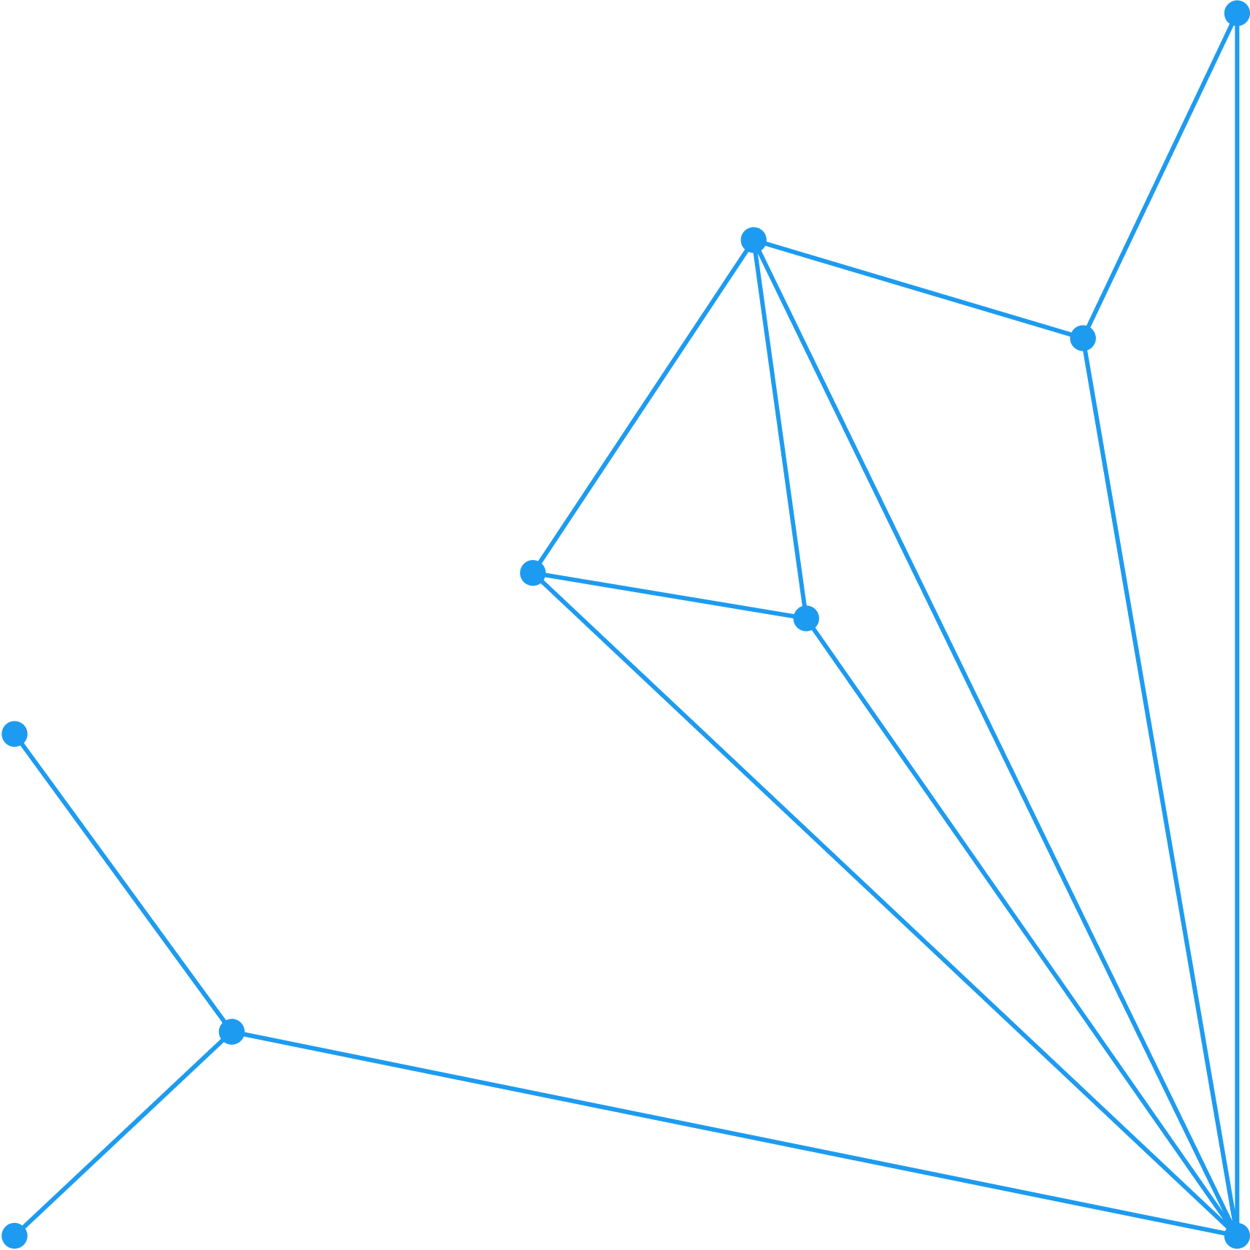


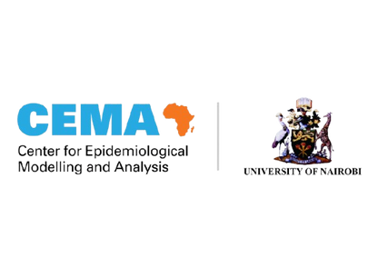


Role of epidemiology in public health & disease control
Githinji Geoffrey,
Infectious Disease Modeller
1

Slide 2
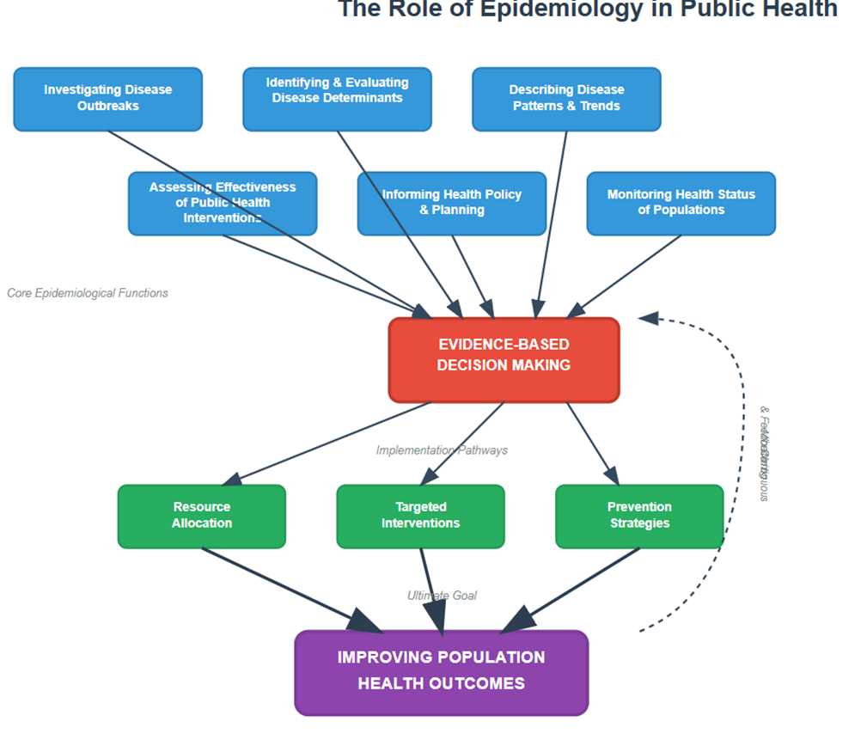
Applied Epidemiology
“ Without monitoring and understanding
how diseases spread, we cannot prevent them ”
Applied epidemiology - application of epidemiologic principles to address public health issues
Epidemiology serves as a critical bridge - connecting pure scientific discovery with practical public health action
synthesizes knowledge from diverse scientific fields to translate complex scientific understanding into tangible health improvements
Work to assess, monitor, investigate and prevent public health problems
Provide crucial information for
  Health promotion
  Public health policy
  Management efforts
2

Slide 3
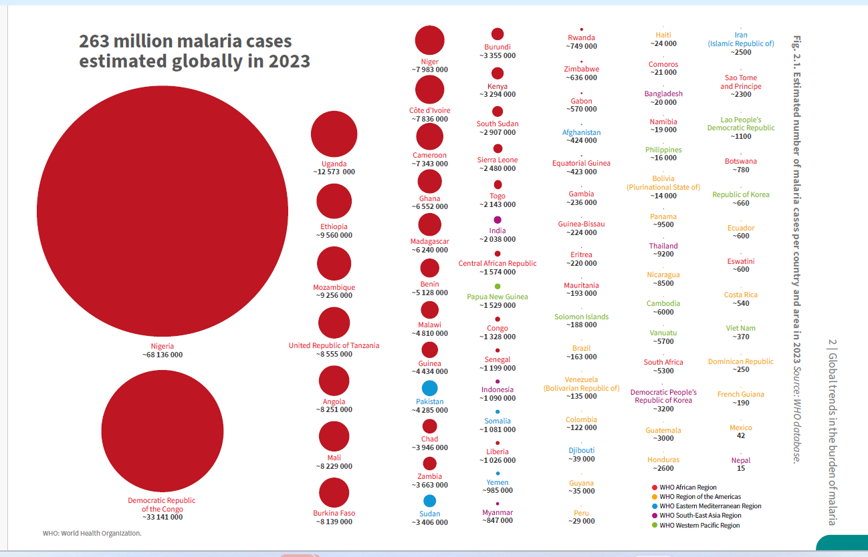
Epidemiology Core Functions
Disease Surveillance: The Backbone of Public Health
  Systematic, ongoing collection, analysis, and interpretation of health data, which is crucial for guiding public health action
  Primary goals of surveillance:
    Early outbreak detection
    Continuous monitoring of disease trends over time
    Evaluating the effectiveness of public health interventions
  Data derived from surveillance
    Directly informs public health decision-making, resource allocation, and policy development at local, national, and international levels
3

Slide 4
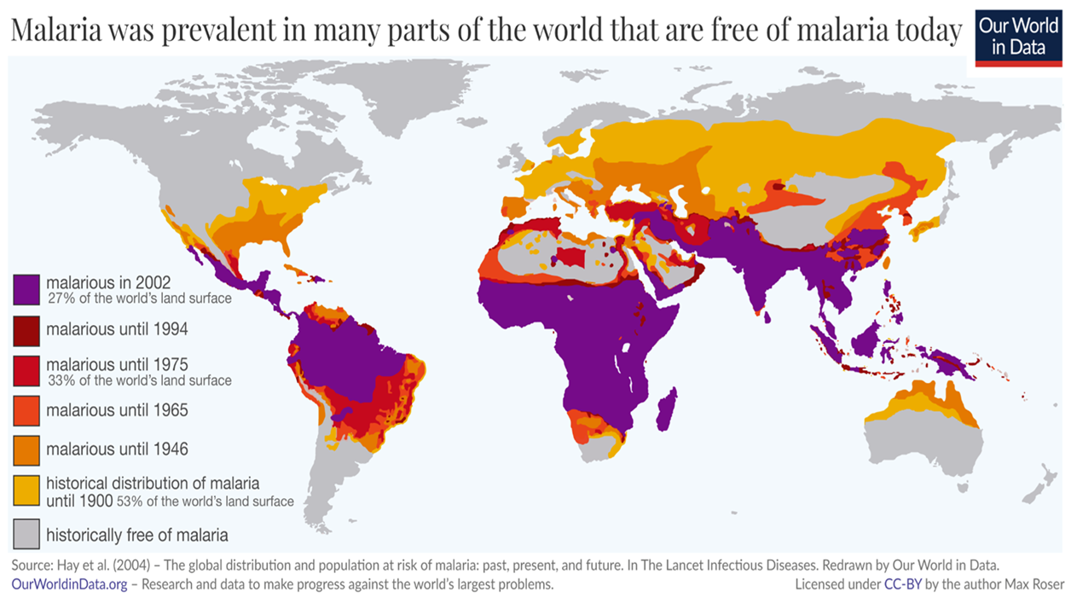
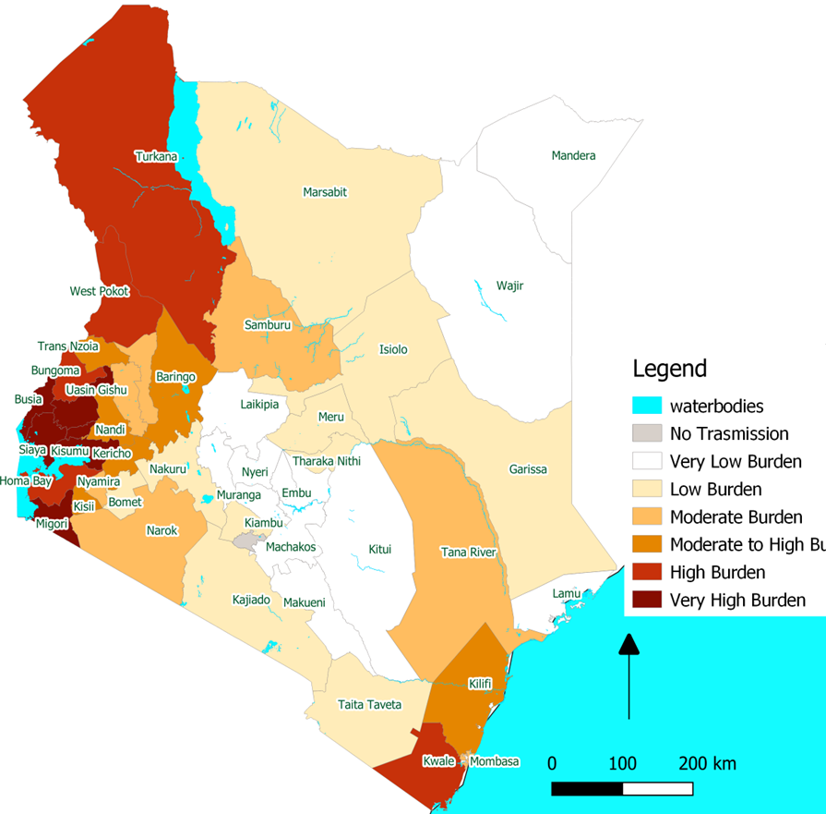
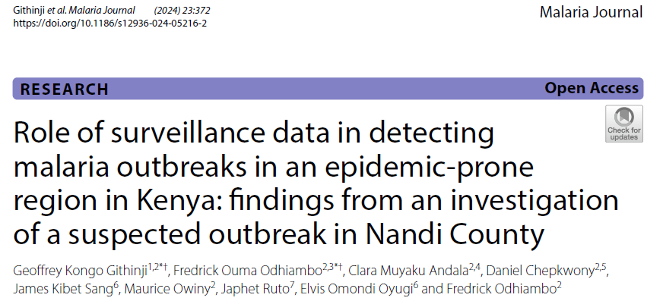
3

Slide 5
Epidemiology Core Functions
Outbreak Investigation: Rapid Response and Containment
Typically triggered by routine surveillance systems
Outbreak investigation - direct applied consequence of effective surveillance
Rapid identification of an outbreak is paramount for effective containment
Illustrates seamless operational loop
  Where surveillance triggers investigation
  Investigation applies epidemiological study methods to understand the problem
  The findings then feed back into refined surveillance and control measures
3

Slide 6
Epidemiology Core Functions
Guiding Interventions & Policy: Malaria Control in Focus
Epidemiological insights - translated into effective public health interventions and policy formulation
Translating Epidemiological Insights into Action
  Plays a crucial role in assessing the short- and long-term impacts of various disease control strategies
  Examples – Evaluating Vector Controls measures – LLINs, Chemo preventive therapies, Understanding key epidemiological factors - risk factors for disease, patterns of transmission etc
Emerging Trends & Future Directions
  Modern epidemiology is increasingly integrating cutting-edge technologies - LLMs
  Addressing rapid transformation driven by technological advancements
Persistent foundational challenges
3

Slide 7
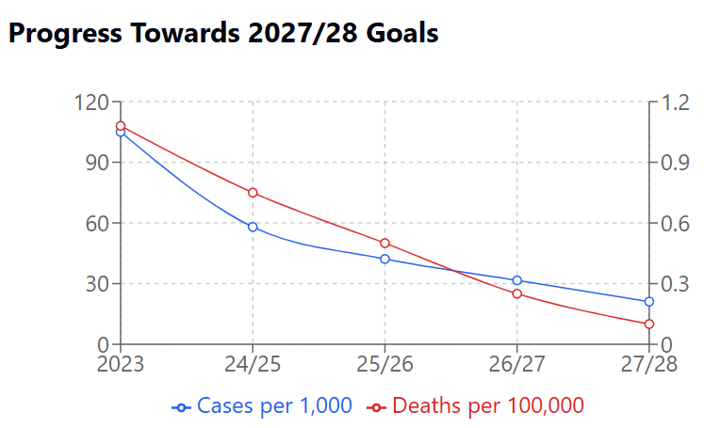
Kenya Malaria Strategic Plan 2023 - 2027 Goal and Targets
Goals
To reduce malaria incidence by at least 80 percent and deaths by at least 90 percent of the 2023 levels by 2027/28
To interrupt indigenous malaria transmission in selected counties by 2027/2028
3

Slide 8
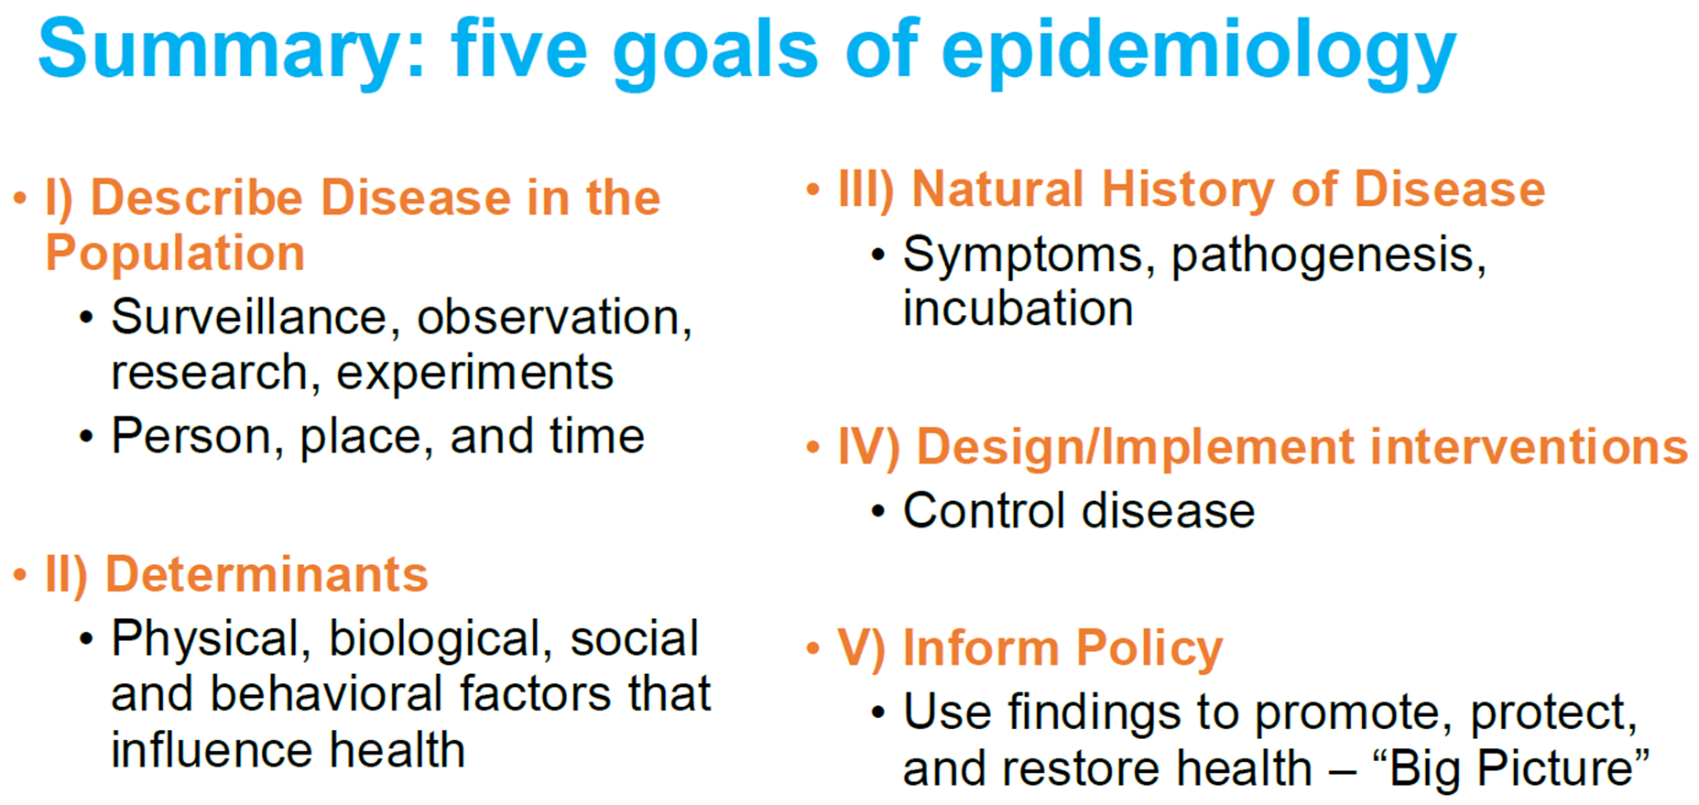
3

Slide 9
Epidemiology study designs and their applications
Alice Kamau
1

Slide 10
Fundamental assumptions of Epi
Disease does not occur in isolation
  Disease is not randomly distributed throughout a population
  Epidemiology uses systematic approach to study the differences in disease distribution in subgroups
  Allows for study of causal and preventive factors
  Assesses disease distribution
    Who is getting the disease (e.g. sex, age)?
    Where is the disease occurring (e.g. hotspots)?
    When is the disease occurring (e.g. seasonality)?
  Identifies determinants of disease – hypothesis are tested using epi studies
3
Notes:
One of the fundamental assumptions of epidemiology is that disease does not occur in isolation—understanding the context is key to effective prevention and control.
Disease is not randomly distributed; certain populations, locations, and time periods face higher risks.
These patterns often point to underlying causes or risk factors.
Epidemiology uses a systematic approach to compare disease occurrence across different subgroups.
This involves identifying the people most affected (e.g., by age, sex, occupation, socioeconomic status), mapping geographic hotspots or high-risk areas, and tracking time trends, seasonality, and epidemic curves.
The observed patterns form the basis for generating hypotheses about the determinants of disease.
These hypotheses are then tested through well-designed epidemiological studies.
The ultimate goal is to move from understanding patterns to developing and implementing interventions that prevent disease.

Slide 11
Why study designs matter
Study designs vary based on the research question, feasibility, and ethical considerations.
Guides how we collect, analyse, and interpret data
Impacts validity, bias, and causality
Goal: evaluate association between an exposure and outcome as well as effect modifiers
3
Notes:
Directly influences the validity of findings, the potential for bias, and the ability to draw causal inferences.
The goals of many research studies are to evaluate the association between an exposure (eg, bednet use) and an outcome (eg, malaria incidence) and to identify the factors that may modify the exposure’s effect on the outcome.
Would you like me to also make a short, bullet-style version that fits neatly on a presentation slide?

Slide 12
Classification of Study Designs
Two broad categories:
  Experimental studies
  Observational studies
References
Manja V, Lakshminrusimha S. Epidemiology and Clinical Research Design, Part 1: Study Types. Neoreviews. 2014;15(12):e558-e569. doi:10.1542/neo.15-12-e558
Manja V, Lakshminrusimha S. Epidemiology and Clinical Research Design, Part 2: Principles. Neoreviews. 2015;16(2):e94-e108. doi:10.1542/neo.16-2-e94
https://www.taylorfrancis.com/books/mono/10.1201/b16343/epidemiology-mark-woodward-mark-woodward
https://www.harvard.com/book/9781451193282
https://www.abebooks.com/9781584880097/Epidemiology-Study-Design-Data-Analysis-1584880090/plp
3

Slide 13
Experimental Study Designs
Assesses efficacy of a product or intervention.
Designed to establish causality
Clinical trials are the gold standard
Randomised Controlled Trials (RCTs) determines whether experimental treatments are effective and safe
Others:
        Cluster randomized trial
        Adaptive
        Stepped-wedge etc.
2
Notes:
In experimental studies, the investigator assesses the efficacy of a product or intervention for the treatment or prevention of diseases or health problems.
These studies are designed to establish causality by controlling the allocation of the intervention.
Clinical Trials are considered the gold standard for evaluating interventions because they use rigorous methods to minimise bias.
The most common type, Randomised Controlled Trials, involves randomly assigning participants to a treatment or a control groups
RCTs determines whether experimental treatments are effective and safe under a “controlled environment”
Beyond traditional RCT, there are several other experimental study designs e.g. cluster randomised trial, adaptive trial design etc

Slide 14
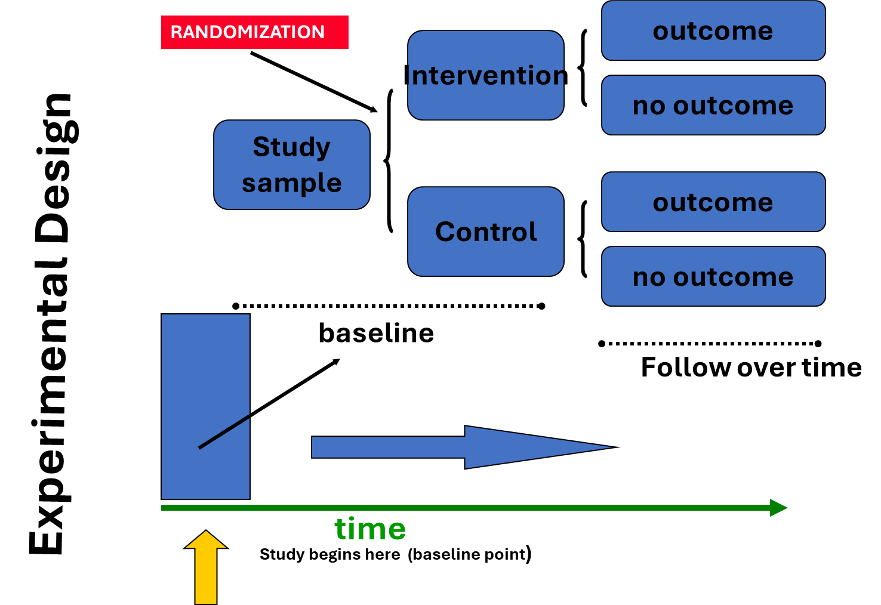
2
Notes:
In experimental design, the study begins with a baseline period to compare key outcomes and confounder between groups after randomisation.,
Participants are then randomisation into intervention and control groups.
Followed by a follow-up period to measures the outcome of interest to assess the intervention’s effect.

Slide 15
Observational Study Designs
Descriptive - describing the frequency or characteristics of event
Case reports - is a detailed presentation of a single case or a handful of cases,
Case series - is a general report on new/unique conditions
Analytical - testing relationships between exposure and outcomes: Cross-sectional studies, case-control, cohort (prospective & retrospective)
2
Notes:
Observational studies may be descriptive in nature (describing the frequency or characteristics of events) or analytic (testing relationships between exposure and outcomes).

Slide 16
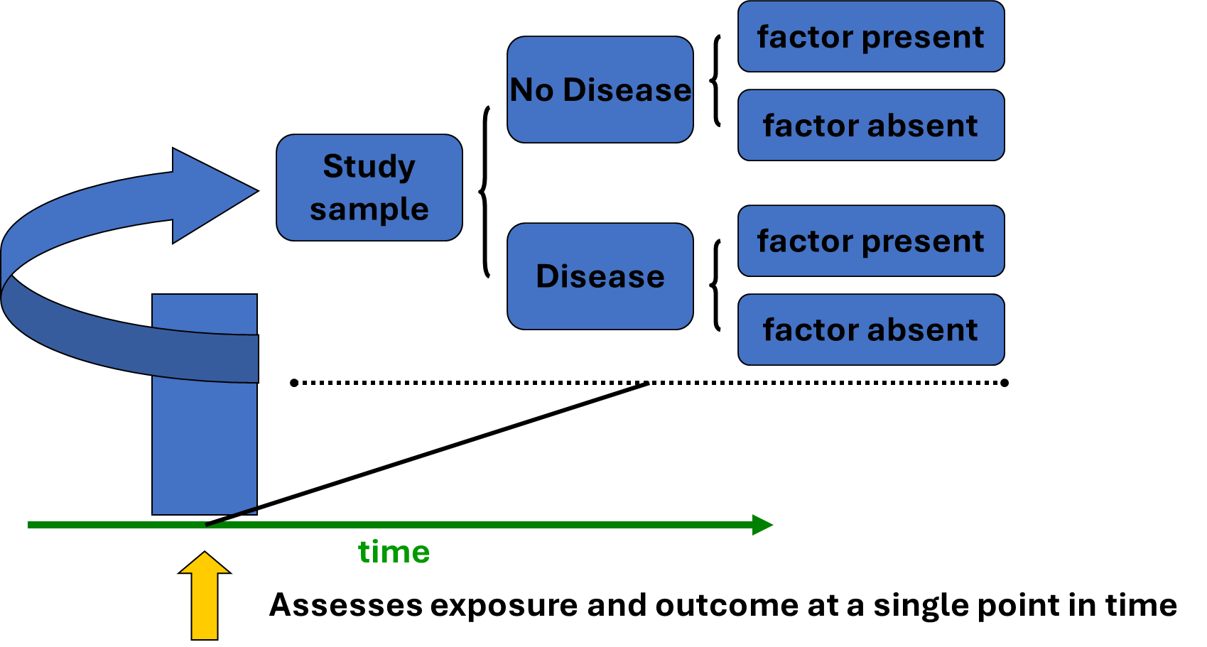
Cross-sectional Design
Description | Key Feature | Example Use Case
Assess exposure and outcome at a single point in time | Snapshot in time Strengths: Quick, cheap Limitations: No temporality | Household survey measuring both malaria infection status (outcome) and bed net use (exposure) during a single survey round
2
Notes:
Cross-sectional studies assesses both the outcome and exposure at a single point in time or over a very short period.
They provide a “snapshot” of the population, allowing estimation of the prevalence of disease and explore associations between exposures and outcomes.

Slide 17
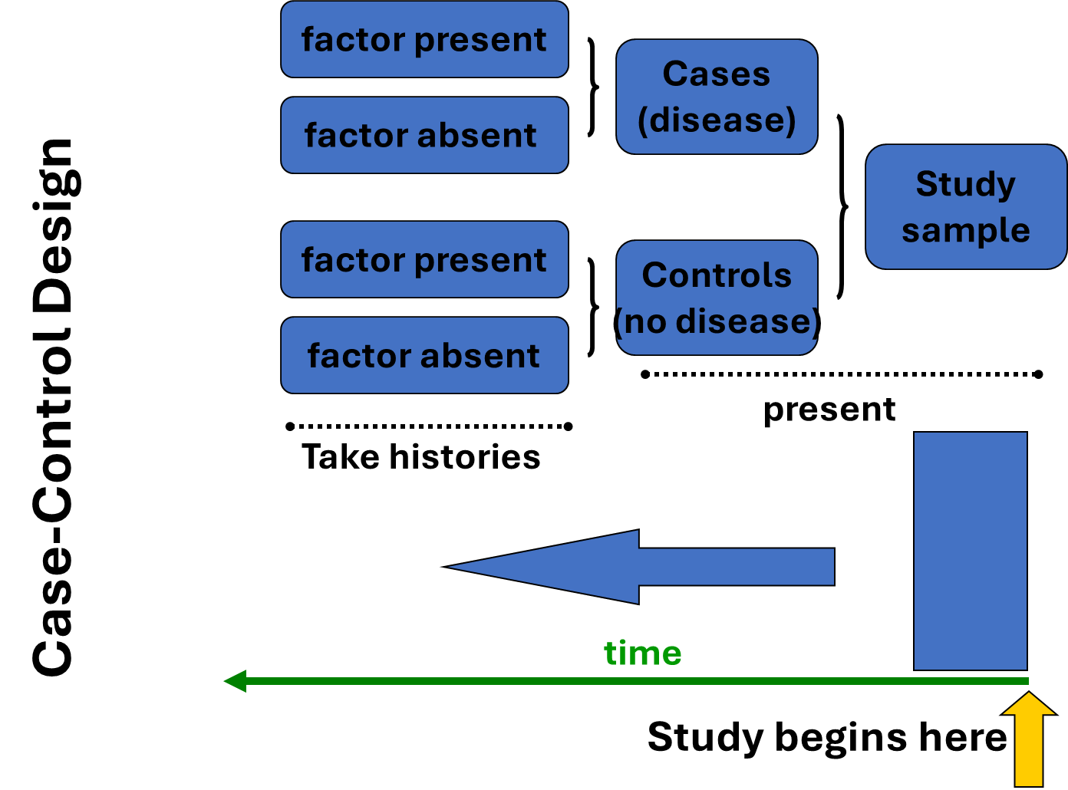
Description | Key Feature | Example Use Case
Compare individuals with a condition (cases) to those without (controls) | Outcome → Exposure Strengths: Good for rare diseases Limitations: Recall and selection bias | Investigating a malaria outbreak by comparing recent travel history among confirmed malaria cases versus healthy community controls.
2
Notes:
Case-control studies begin by identifying individuals with the outcome of interest (malaria cases) and a comparable group without the outcome (controls).
Researchers then look back in time to assess prior exposures or risk factors.They can identify associations but not causality.

Slide 18
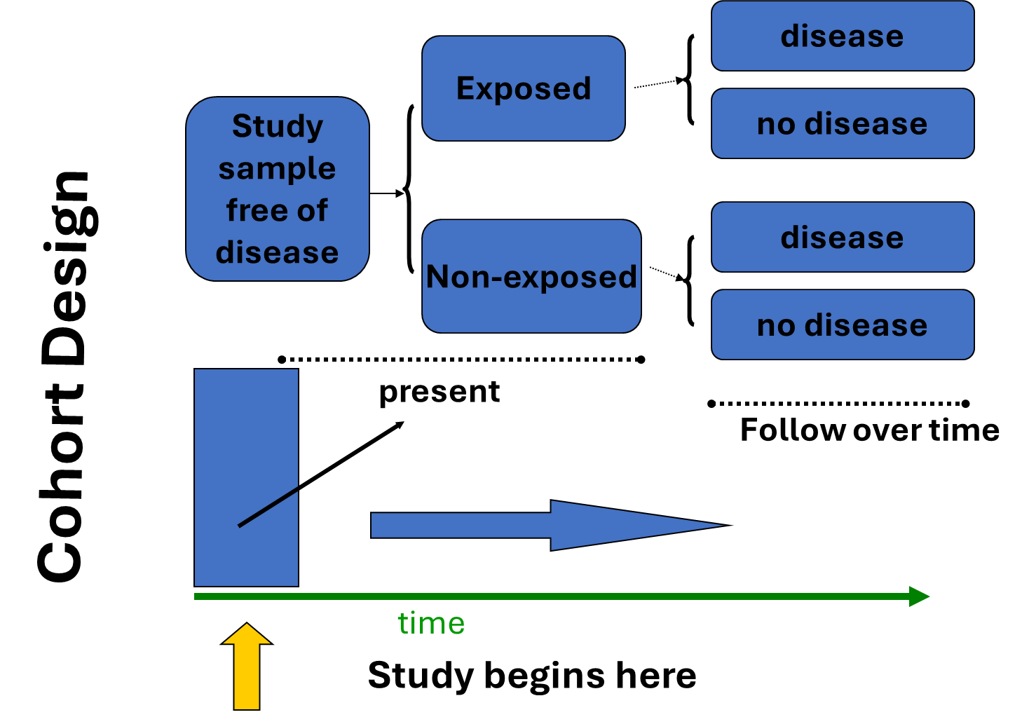
Description | Key Feature | Example Use Case
Follow a group over time to assess outcome occurrence | Exposure → Outcome Strengths: Establish temporality Limitations: Expensive, time consuming, loss to follow-up | Following a cohort of children who use bed nets (exposed) and those who do not (unexposed) to compare the incidence of malaria over two years
2
Notes:
Cohort study begin by classifying participants into exposed and unexposed groups, then follows them over time to observe the occurrence of the outcome of interest.
They can be prospective (tracking participants forward in time from exposure to outcome) or retrospective (using existing records to reconstruct exposure and follow-up).

Slide 19
Summary
Study designs guide how we generate evidence
Observational vs experimental
Correct application is key to reliable conclusions
Think: “What is the best design to answer my question?”
3

Slide 20
Questions?
3

Slide 21
Practical
3

Slide 22
Lesson 2 Group Exercises:
Instructions for the groups:
Please read the following public health scenarios
As a group, discuss the situation and answer the following questions that follow
  Formulate a primary hypothesis
  Propose most appropriate epidemiological study design to quickly and efficiently test your hypothesis
  Provide a clear rationale for why this study design is the best choice given the circumstances
  Define your study sample population
    Inclusion criteria
You will have 20-25 minutes for this exercise
3

Slide 23
Exercise Case Study
Scenario 1:
In the past three months, the main public health facility in a low endemicity county has reported an unusual increase in the number of children under five years of age presenting with severe malaria. This is unexpected. The Ministry of Health, with support from partner organizations, has concluded a successful mass distribution campaign of long-lasting insecticidal nets (LLINs) across the county six months ago. Reports from healthcare workers suggest that many of the children with severe malaria come from households that received the new bed nets. This has raised concerns among public health officials and the community about the effectiveness of the recently distributed nets
As a team of epidemiologists, you have been tasked with rapidly investigating the potential risk factors associated with this recent surge in severe malaria cases to inform an immediate public health response
3

Slide 24
Exercise Case Study
Scenario 2:
In October 2021, RTS,S became the first malaria vaccine recommended by the WHO for broad use in children. The RTS,S/AS01 malaria vaccine (also known as Mosquirix) was introduced into routine childhood immunisation programs in selected high-transmission regions in Kenya. While Phase III clinical trials have shown efficacy, it is essential to assess vaccine performance under real-world conditions, where cold chain, adherence, and co-interventions may vary.
As a team of epidemiologists, you have been asked to evaluate the effectiveness of RTS,S in preventing malaria infection and clinical disease among vaccinated versus unvaccinated children over a 2-year follow-up period.
3

Slide 25
Exercise Case Study
Scenario 3:
Malaria transmission persists in areas with high insecticide-treated net coverage due to early evening or outdoor biting. Spatial repellents, devices that release volatile chemicals to disrupt mosquito-human contact, are a promising complementary tool. Semi-field studies have shown potential, but real-world, community-level impact is unclear.
As a team of epidemiologists, you have been tasked to evaluate the efficacy of long-acting spatial repellent product in preventing clinical malaria in a high-transmission area.
3

